Slide 1
ECMWF Data Processing Workshop

Slide 2
ECMWF DATA ACCESS
Read-Only FTP accounts
HOST: 121.58.193.88 POST: 21
Section | Username | Password
Weather Division | ecmwf-wd | Xqzb95x2
Hydromet Division | ecmwf-hmd | UfiEG2HZ
Numerical Modelling Section | ecmwf-nms | 1FiSW6zs
Climate and Agromet Division | ecmwf-cad | n7nmxRMZ
Hydrometeorology, Tropical Meteorology & Instruments Development & Research Division | ecmwf-htmirds | UyoMTYk9

Slide 3
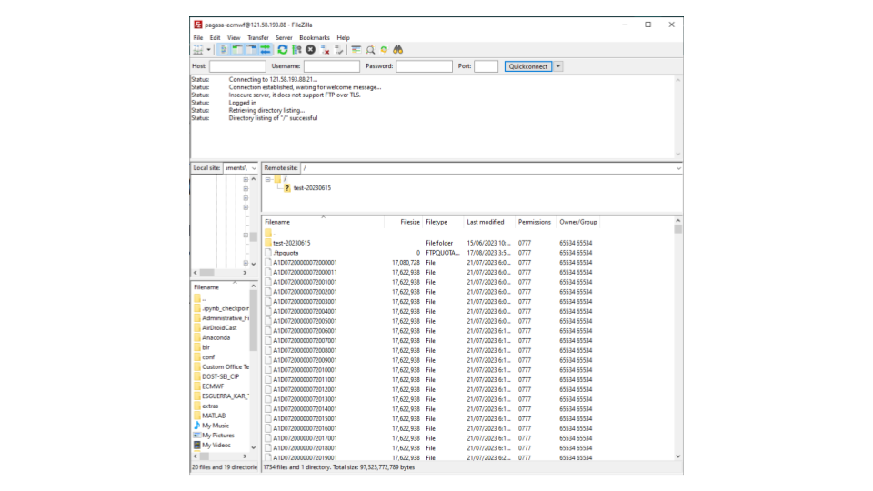
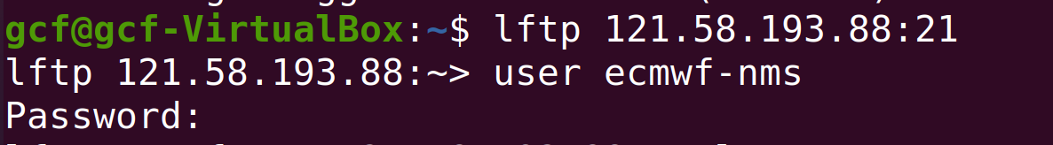
ECMWF DATA ACCESS
THRU FILEZILLA
THRU TERMINAL

Slide 4
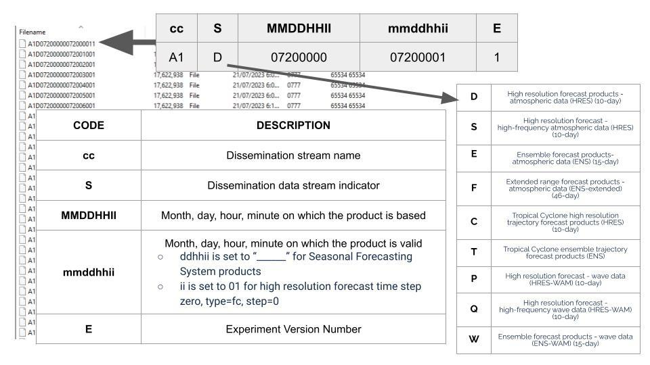
ECMWF DATA FILENAME

